Slide 1

Automated Unit Testing
Moonzoo Kim
moonzoo.kim@gmail.com

Slide 2
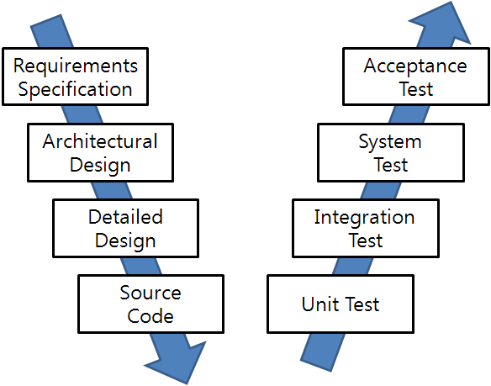
SW Development and Testing Model (V model)
Manual
Labor
Abstraction

Slide 3
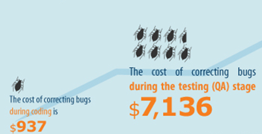
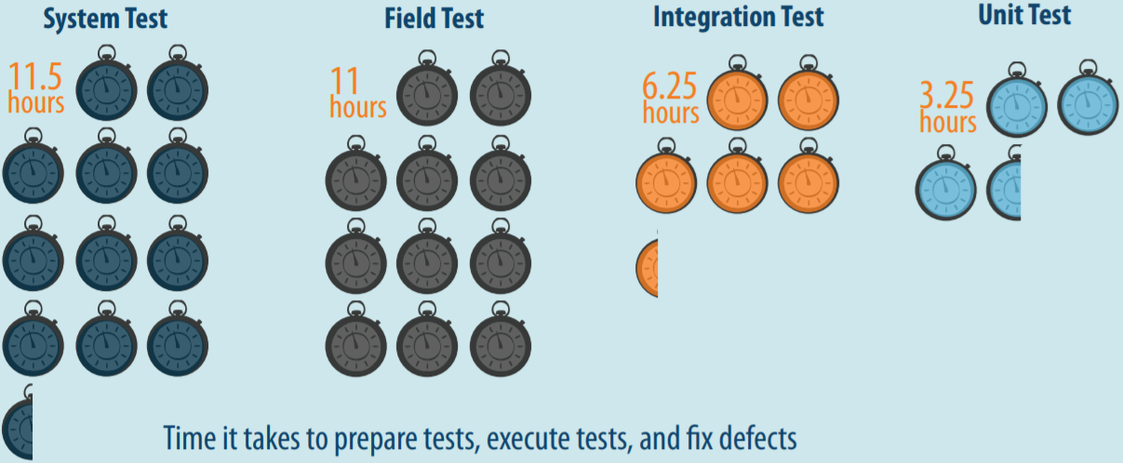
Many Benefits of Unit Testing
Bug correction cost: 7x cheaper than system tests
$937 (unit test) vs $7,136 (system test)
Bug correction time: 3x faster than system testing
3.25 hours vs 11.5 hours
Source: B. Boehm and V. Basil, Software Defect Reduction Top 10 List, IEEE Computer, January 2001
Source: Capers Jones, Applied Software Measurement: Global Analysis of Productivity and Quality
Notes:
All of us know that unit testing has benefits over system testing. Unit testing is 7 times cheaper than system testing to detect and fix a bug as well as unit testing is 3 times faster than system testing to run and detect a bug. Unfortunately, such benefits of unit testing is not much enjoyed in real-world because of false alarm problems. To run a target unit in an isolated environment for unit testing, we have to write down stub and mock functions to provide contexts to the unit. If such stub and mock functions provide inaccurate context, unit testing raises a false alarm, which is feasible in unit execution, but infeasible in system execution. Such false alarm problem is severe in automated unit test generation techniques because such techniques do not know the appropriate context of the target unit. To address such false alarm problems in automated unit test generation techniques, we propose two ideas

Slide 4
f()
3 exec. paths
g()
3 exec. paths
h()
3 exec. paths

Slide 5
f()
f() + g()
f()
3 exec. paths
g()
g()
g()
g()
9 (=3²) execution paths
3 exec. paths
h()
3 exec. paths

Slide 6
f()
f() + g() + h()
f()
3 exec. paths
g()
g()
g()
g()
h()
h()
3 exec. paths
h()
27 (= 3³ ) execution paths
3 exec. paths

Slide 7




Pros and Cons of Auto. Test Gen. in System-level
Pros: No false alarms
Cons: Low bug detection power due to large search space
Execution tree
Explored paths of a program
Real bug
Notes:
Nowadays, automated test generation techniques are widely used in academia and industry at system-level and unit-level. First, let’s look at the pros and cons of system-level test generation.
The pros of system-level test generation is that we do not need to worry about false alarm. We can give any inputs to a target program and the program should handle unexpected inputs.
On the other hand, the cons of system-level test generation is low bug detection power due to large search space. Within a given limited time, it can explore only a few part of search space, so it can miss corner case bugs.

Slide 8
Automated Test Generation in System-Level
Pros
+ Can be easy to generate system TCs due to clear interface specification
+ No false alarm (i.e., no assert violation caused by infeasible execution scenario)
Cons
- Low controllability of each unit
- Large and complex search space to explore in a limited time
- Hard to detect bugs in corner cases
T₁
T₂
T₃
T₄
Different system tests T₂ to T₄ exercise the same behavior of the target unit
g1
g2
f
h1
h3
h2
Notes:
장점 Sys tc 만들기 쉽다.
Search space 가 너무 커서 어려움
시간문제
그림 컴포넌트 구분 안감 (입체감)

Slide 9




Pros and Cons of Auto. Test Gen. in Unit-level
Pros: High bug detection power for small search space
Cons: Many false alarms due to over-approximated context of a unit
[Gross et al., ISSTA12]
[Fraser and Arcuri, ESEJ13]
[Shamshiri et al., ASE15]
main
Execution tree
f₂
Explored paths of each unit
f₁
f₃
Real bug
False alarm
f₄
f₅
f₆
f₇
f₈
f₉
Notes:
Unit-level test generation has entirely different charateristics. Pros of unit-level test generation is that it has high bug detection power because It can control individual unit functions which has small search space. However, unit-level test generation causes many false alarms because it can give any inputs to a target unit, but the inputs may not be feasible in system-execution. Many papers pointed out such false alarm problem is severe.
3~5 slides 애니메이션으로
조금 더 타이트하게. 너무 쳐지지 않게.

Slide 10
Automated Test Generation in Unit-Level
Pros
+ High controllability of a target unit
+ Smaller search space to explore than system testing
+ High effectiveness for detecting corner cases bugs
Cons
- Hard to write down accurate unit test drivers/stubs due to unclear unit specification
- High false/true alarm ratio
Different unit tests T_{u1} to T_{u3} directly exercise different behaviors of the target unit, but T_{u2} to T_{u3} exercise infeasible paths
g1
T_{u1}
T_{u2}
g2
T_{u3}
Legend
f
A feasible execution
h1
h3
An infeasible execution
h2
Notes:
드라이버/스텁
Tu2, 3 로 가장 표면에서 가는 선 없는 거 보이기(visual)

Slide 11
Automated Unit Test Generation with Realistic Unit Context
Pros
+ High controllability of a target unit
+ High effectiveness for detecting corner cases bugs
+ Low false alarm ratio
Realistic unit context filters out unit tests that exercise infeasible paths
Unit tests T_{u4} that exercises an infeasible path is filtered out by the unit context
Different unit contexts explore various behaviors of f
T_{u4}
T_{u5}
g1
T_{u6}
g1
g2
g2
Legend
A feasible execution
f
h1
h3
An infeasible execution
h3
h2
h2
Notes:
드라이버/스텁
Tu2, 3 로 가장 표면에서 가는 선 없는 거 보이기(visual)

Slide 12
Approximate Input Space for Symbolic Unit Testing
Over-approximated symbolic inputs
Infeasible input raising a false alarm
Real inputs to a target unit
False
negative
Under-approximate
symbolic inputs
User-specified
symbolic inputs

Slide 13
Related Work on Automated Unit Testing
 | Bug detection ability | False/True alarm ratio | Target languages
Function input generation [PLDI 05][FSE 05][EMSOFT 06][TAP 08][ISSTA 08][SEC 15] | High | High | Procedural or OO languages
Method-sequence generation [ICSE 07] [ICST 10][FSE 11] [ICSE 13] | High | Medium | Object-oriented languages
Capture system tests to generate unit tests [TSE 09] [STTT 09][ISSTA 10] | Low | Low | Object-oriented languages
Automated Unit Test Generation with Realistic Unit Context | High (86.7% of target bugs in SIR and SPEC2006) | Low (2.4 false alarms per one true alarm) | Procedural languages

Slide 14
Constructing Unit Test Driver/Stubs
Example of an automatically generated unit-test driver
01:typedef struct Node_{
02: char c;
03: struct Node_ *next;
04:} Node;
05:Node *head;
06:// Target unit-under-test
07:void add_last(char v){
08: // add a new node containing v
09: // to the end of the linked list
10: ...}
11:// Test driver for the target unit
12:void test_add_last(){
13: char v1;
14: head = malloc(sizeof(Node));
15: SYM_char(head→c);
16: head→next = NULL;
17: SYM_char(v1);
18: add_last(v1); }
Unit Test Driver
Generate symbolic inputs for global variables and parameters
Set global variables
Call target function
Set parameter

Slide 15



Trade-off between Bug Detection Ability and Accuracy
Bug Detection Ability
(aiming low false negative)
Bug Detection Accuracy
(aiming low false positive)
Recall
Precision

Slide 16


Cutting-edge Accuracy of Unit Testing
CONBRIO [Kim’18]: 4.5:1 w/ 91% of bugs detected
Randoop: 5.9:1 [Gross et al., 2012]
Evosuite: 6.3:1
[Fraser and Arcuri, 2013]
UC-KLEE: 5.7:1
[Ramos and Engler, 2015]
OOP features
Manual Assumption
Notes:
OOP 타겟 도움 받음, 쉽다. OOP 얘기 하지말고
Randoop, Garg et al., Evosuite, UC-KLEE False alarm 비교 슬라이드

Slide 17

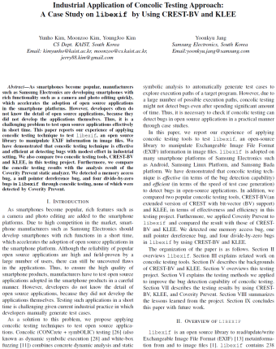
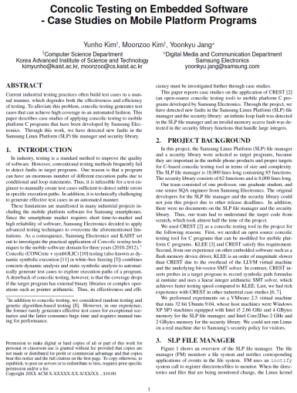
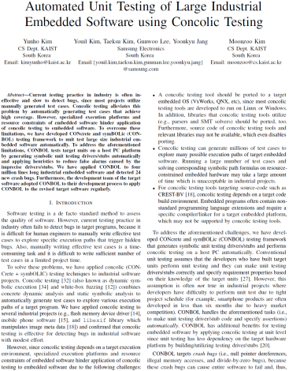

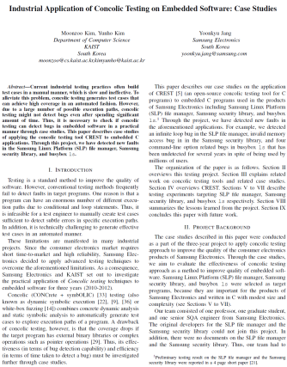



Concolic Unit Testing Project w/ Samsung DMC for 5 years
Goal: To detect bugs in Samsung smartphones
Project period: ‘10~’14
Project funding: 400,000 USD
Results:
Developed Concolic unit-testing tool CONBOL
Detected many crashes in 4 MLOC smartphone SW
Industrial project progress
2011
2012
2013
2014
2010
ICSE 2012, ICST 2012
FSE '2011
ASE 2013

Slide 18
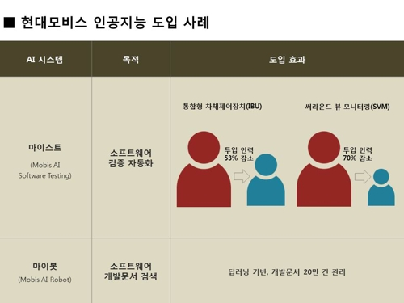


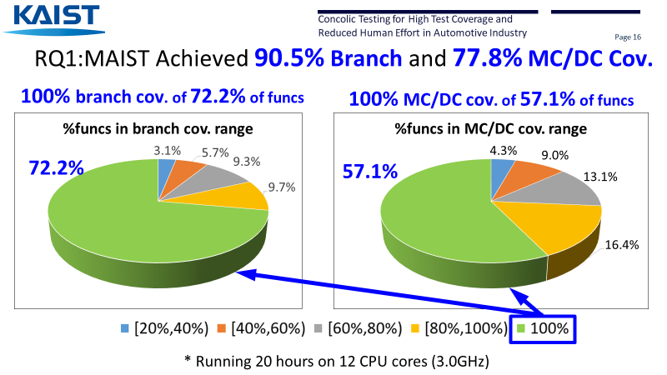
Concolic Unit Testing Project w/ Hyundai and Mobis for 5 years
MAIST
Test harness generator
Test
drivers/
stubs
MAIST
Test input
generator
Driver gen.
Test cases
Target
C code p
Stub gen.
Search strategy coordinator
MAIST
Converter
Target
C code p’
CROWN
Coverage
Report
http://m.yna.co.kr/kr/contents/?cid=AKR20180720158800003&mobile
Bit-field transform.
Legend
CROWN features
- Bit-level accuracy
- Easy-to-extend
- Low memory overhead
MAIST
External tool
C code
Notes:
말풍선 사라지지 않게
CROWN features
솔루션이랑 매칭되게

Slide 19
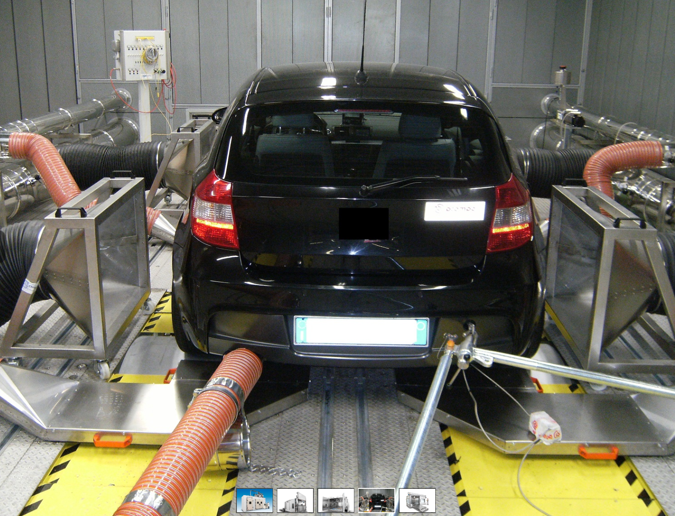
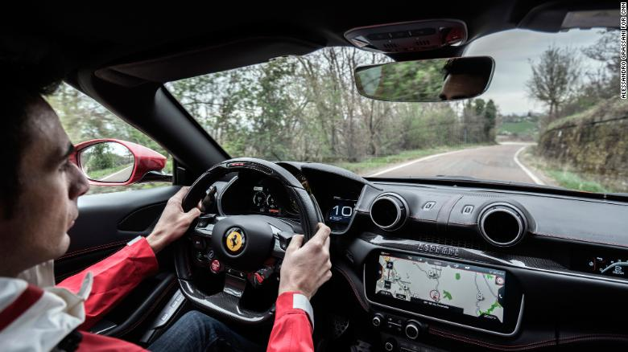




Practical Benefit of Automated Unit Testing
System testing is expensive and less effective
Full vehicle HW and human drivers are required
Driving a car with various physical environments spends a lot of time
Hard-to-achieve high test coverage due to low controllability
Unit testing is cheap and more effective
Full vehicle HW and human drivers are NOT necessary
No need to drive a car
Easy-to-achieve high coverage due to high controllability
VS
Notes:
Unit testing 서서히 나타나는 애니메이션으로
Compared to system testing requires lots of resources,
Unit testing rmfla\
비주얼
자동차 테스트 장비 등

Slide 20



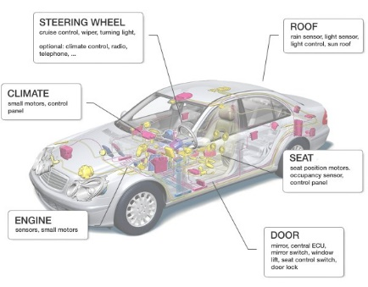




Solution for Huge Economic & Social Cost due to SW Bugs
Labor-intensive Manual Testing Large SW Testing Cost and Time
Low Bug Detection Abilty Low Product Quality
Solution: AI-based Automated Concolic Testing Technique
movie link https://bit.ly/3NS6RrQ
Existing Problems Developed Solutions
‘10-14 Project w/ Samsung Electronics
’15~20 Project w/ Hyundai/Mobis
‘18 Project w/ LIGnex1
’20 Project w/ Natl. Security Research Inst.
Detected dozens of crash bugs in the comm. firmware
Achieved 90% branch cov. and reduced 80% of labor cost by using auto. testing tech.
Detected several SW bugs in the 10 programs in the battleships
Detected SW bugs in the software in the security equipment

Slide 21

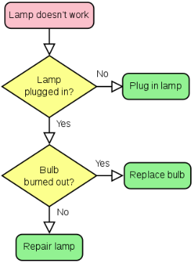

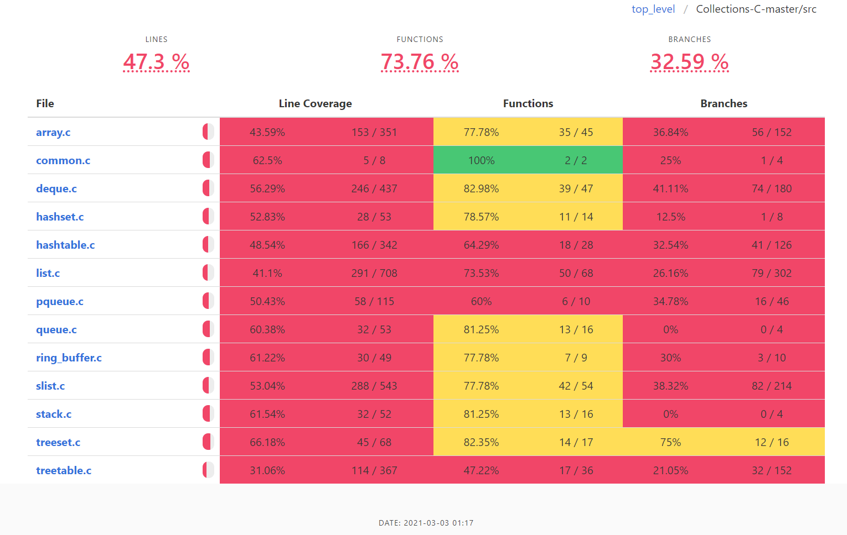
CROWN 2.0: Comercial Automated. Unit Testing Tool
Product Features
CROWN 2.0 is a fully automated software test solution that significantly increases bug detection power and reduces testing cost for embedded C programs
Automatically build stub and driver code
Automatic test case generation based on AI-based Concolic testing
Code-coverage report and analysis
Test execution playback to help in debugging crash bugs
Unit test driver /stub code
C code
CROWN 2.0
AI-based Concolic Testing
Web-based UI
Highlights
HTML bug/
coverage report
Driver/Stubs Generator
Eliminate need to write test code manually
100% automated test code generation
High-quality unit test generation
Integrated code-coverage analysis
Bug/Coverage Reporter

